Slide 1



PUBLIC PERCEPTION OF AI:
INSIGHTS AND IMPLICATIONS
AILA IDEAS Final Project
Project Group 3: Katina Carranza, Shin Aung, Sydni Yang

Slide 2










PROJECT
OVERVIEW
The “Public Perception of AI” dataset on Kaggle compiles a survey of responses reflecting various attitudes toward artificial intelligence. By analyzing this dataset, we extract public insights regarding AI while identifying ongoing trends, concerns, and values amongst many demographics. This helps address potential ethical issues and trust in the adoption of AI while informing strategies for AI integrating into public sectors.

Slide 3

DATASET
OVERVIEW
Kaggle Dataset: “Public Perception of AI”
Format: CSV file, structured data
Number of rows and columns: 17,073 rows, 27 columns
Key features: Article ID and Date, NYT Section, Title, AI Mood, AI Relevance
The “Public Perception of AI” dataset analyzes general public discourse on artificial intelligence (AI) over 30 years. The structured data comes from articles from The New York Times that focus on AI-related topics. This data gives insights to help track and measure public perception changes in public interest and discussions related to AI.

Slide 4


EXPLORE
DATASET
The dataset consists of survey responses focused on concerns and optimism surrounding AI across various domains.
Its structured format makes it well-suited for analysis using statistical and machine learning techniques.
Each column represents a unique aspect of AI perception, including public sentiment, demographic details, impacted sectors, and opinions on AI adoption.
After a thorough evaluation, no major missing or inconsistent entries were identified.

Slide 5
DATASET
ANALYSIS
There were duplicate entires, however we removed them during the cleaning process of the data.
A lot of data required cleaning and standardization to ensure validity and accurate testing, such as reformatting the datetime.
Some of the AI content referred to specific AI applications such as healthcare, which needed to be analyzed differently.
Note that the articles are limited to NYT articles, which might not fully reflect the broader population, containing biases.

Slide 6


STATISTICS
Through visualizations such as bar charts, cluster graphs, linear regressions, and K-means clustering, we found data patterns of AI public sentiment and specific metrics to help analyze how AI will affect businesses and ethical considerations of AI advancements.

Slide 7

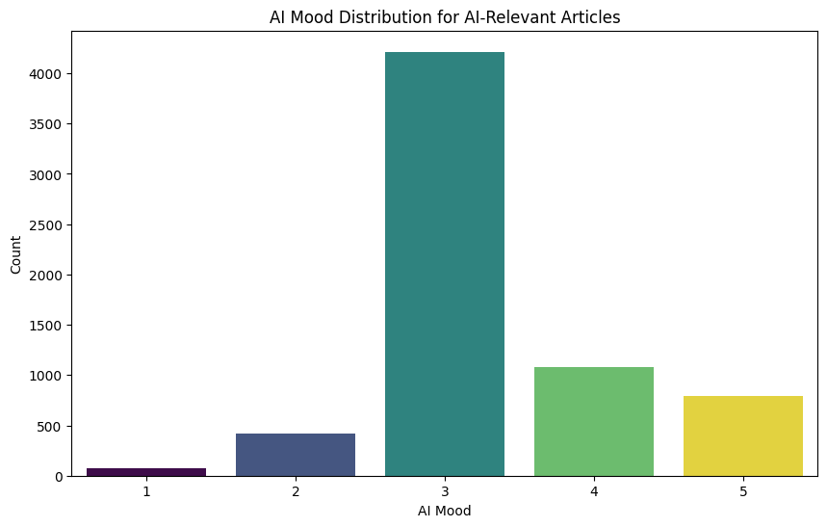
STATISTICS
Conclusion:
AI is generally perceived positively, with trends toward optimism and neutrality.
Minimal negativity highlights areas for improvement.
Notes:
This graph shows the distribution of “AI Mood” ratings (from 1 to 5) in AL-relevant articles. A majority of the results have a rating of 3 in terms of mood, which indicates a neutral feeling towards AI. The next significant portion shows articles with more positive sentiment (ratings of 4 & 5), which suggests that many discussions about AI lean optimistic. There are very few articles with ratings of 1 or 2, which shows that negative feelings toward AI are not as prevalent.
Conclusion/Implication: The data reflects a trend of neutrality and optimism in AI-related discussions, which could potentially increase public interest in AI applications. The minimal negative reviews also reveal concerns some individuals have towards AI, which could raise some awareness of AI products and developments. Overall, this distribution indicates that AI is mostly perceived positively by the public, with some minimal negativity.

Slide 8
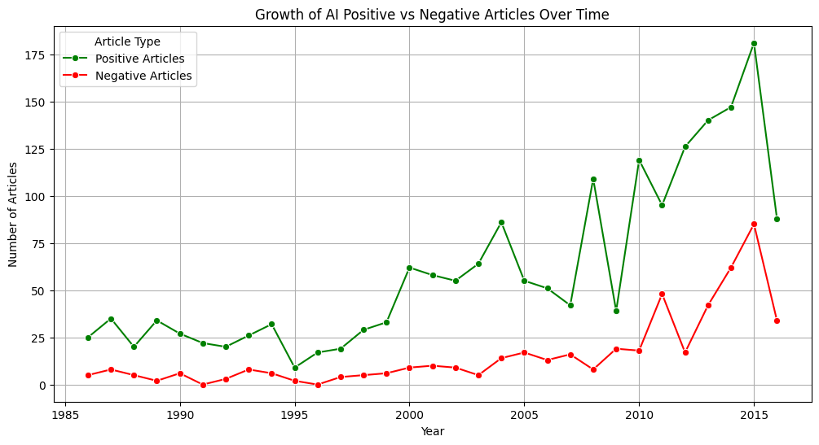
STATISTICS
Conclusion:
Negative articles remained low but still increased alongside the rise in positivity, suggesting growing concerns.
Society is optimistic about AI but increasingly aware of ethical and job-related challenges.
Notes:
This graph compares positive and negative articles about AI publications over time from 1985 to 2015.
Positive Articles:
The green line represents the steady increase of positive perceptions of AI-related articles over time, but especially after the year 2000.
The sharp rise after 2009 and peak around 2015 suggest a growing optimistic perspective about AI advancements.
Negative Articles:
The frequency of articles with negative AI perception has remained quite low compared to the positive frequency.
However, there was a slight increase in negative articles during the same time as the upward trend of positive articles.
These insights demonstrate the persisting optimistic views of AI in society. It also suggests that despite the increasing positivity of advancements in AI, concerns about AI such as ethical implications or job displacement also increase.

Slide 9
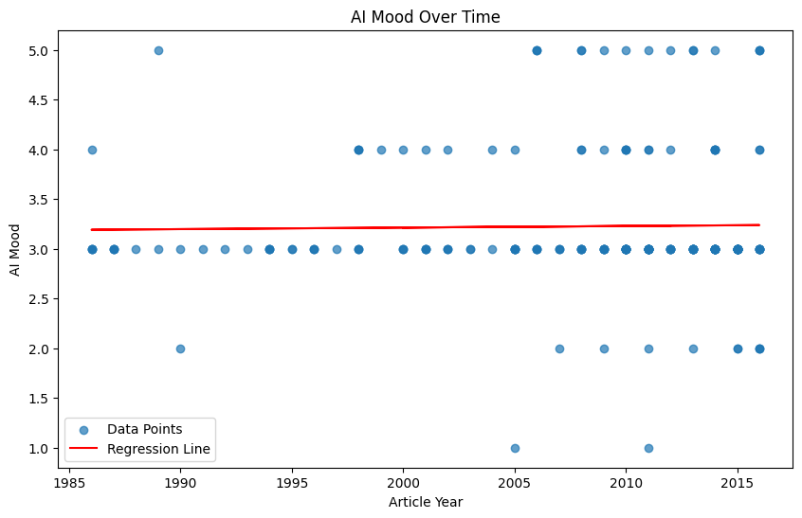
STATISTICS
Conclusion:
AI Mood over time is steadily neutral, leaning towards positivity.
Drastic increase in both spectrums of AI Mood indicates the growing hope as well as the growing concerns regarding AI.
Notes:
This graph compares positive and negative articles about AI publications over time from 1985 to 2015.
Positive Articles:
The green line represents the steady increase of positive perceptions of AI-related articles over time, but especially after the year 2000.
The sharp rise after 2009 and peak around 2015 suggest a growing optimistic perspective about AI advancements.
Negative Articles:
The frequency of articles with negative AI perception has remained quite low compared to the positive frequency.
However, there was a slight increase in negative articles during the same time as the upward trend of positive articles.
These insights demonstrate the persisting optimistic views of AI in society. It also suggests that despite the increasing positivity of advancements in AI, concerns about AI such as ethical implications or job displacement also increase.

Slide 10
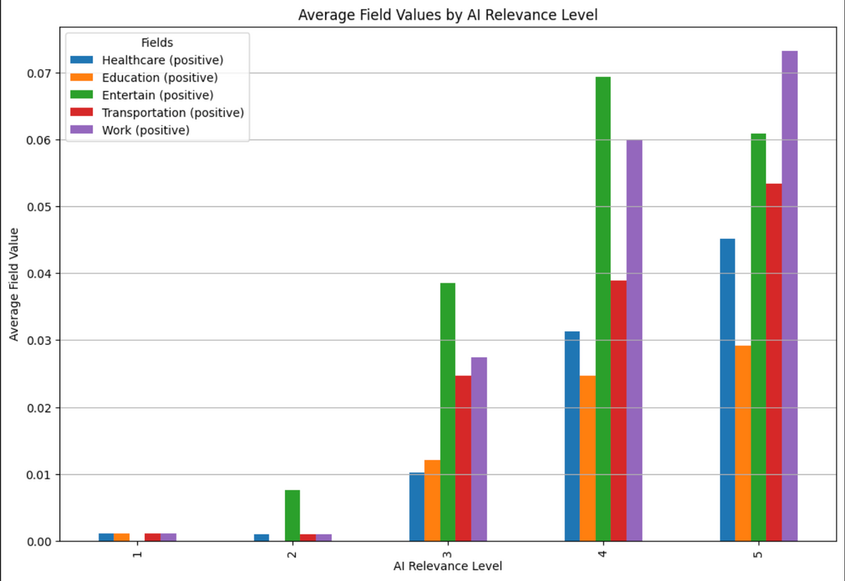
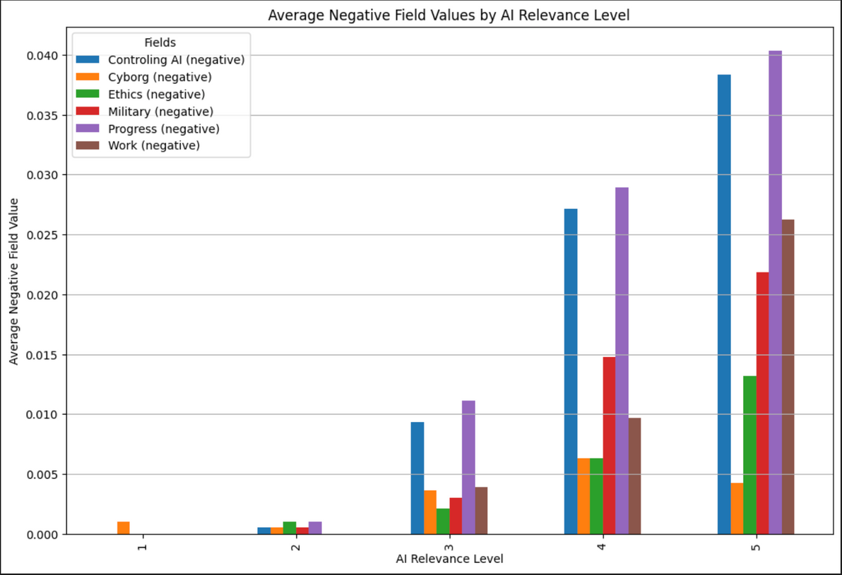
STATISTICS
Conclusion:
As AI relevance increases, positive impacts across fields such as healthcare, education, and more also rise, which highlights a positive view of AI growth.
The right graph shows that as AI relevance increases, negative associations such as controlling AI and ethics also grow, which indicates growing concerns for some potential AI challenges.
Notes:
This graph compares positive and negative articles about AI publications over time from 1985 to 2015.
Positive Articles:
The green line represents the steady increase of positive perceptions of AI-related articles over time, but especially after the year 2000.
The sharp rise after 2009 and peak around 2015 suggest a growing optimistic perspective about AI advancements.
Negative Articles:
The frequency of articles with negative AI perception has remained quite low compared to the positive frequency.
However, there was a slight increase in negative articles during the same time as the upward trend of positive articles.
These insights demonstrate the persisting optimistic views of AI in society. It also suggests that despite the increasing positivity of advancements in AI, concerns about AI such as ethical implications or job displacement also increase.

Slide 11
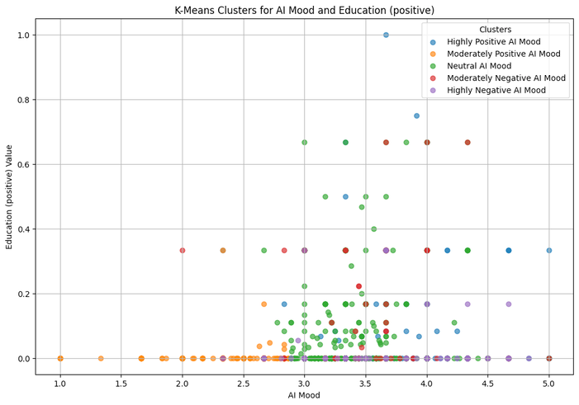
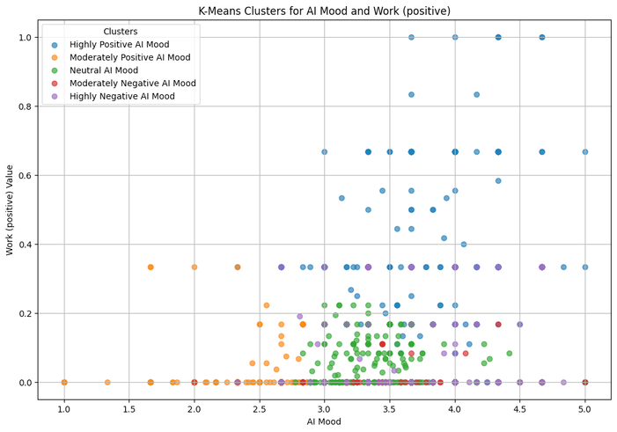
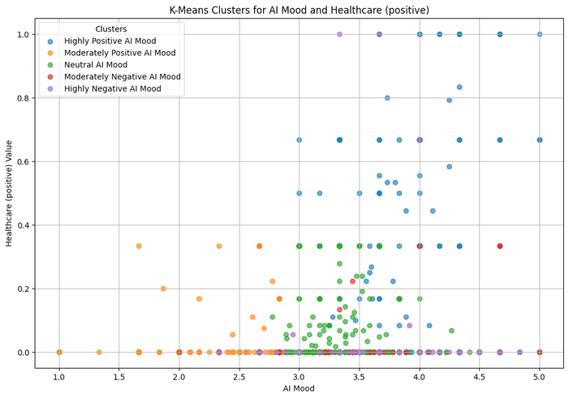
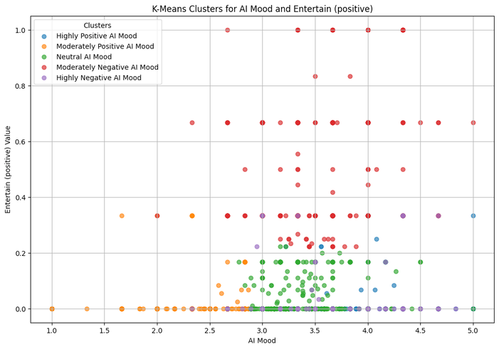
STATISTICS
Conclusion:
AI mood has a significant positive correlation in fields such as education, work, healthcare, and entertainment.
Fields such as entertainment show more variation across mood clusters, while others like healthcare and education have consistent trends with higher AI moods.
Notes:
This graph compares positive and negative articles about AI publications over time from 1985 to 2015.
Positive Articles:
The green line represents the steady increase of positive perceptions of AI-related articles over time, but especially after the year 2000.
The sharp rise after 2009 and peak around 2015 suggest a growing optimistic perspective about AI advancements.
Negative Articles:
The frequency of articles with negative AI perception has remained quite low compared to the positive frequency.
However, there was a slight increase in negative articles during the same time as the upward trend of positive articles.
These insights demonstrate the persisting optimistic views of AI in society. It also suggests that despite the increasing positivity of advancements in AI, concerns about AI such as ethical implications or job displacement also increase.

Slide 12

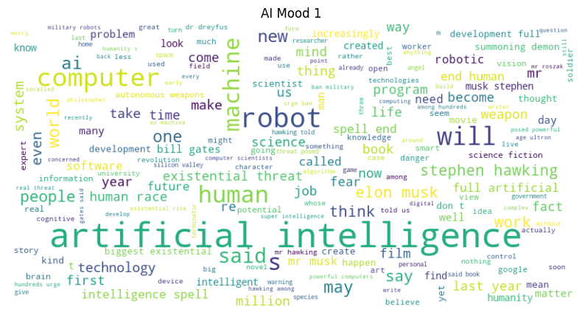
ANALYZING
WORDCLOUDS

Slide 13
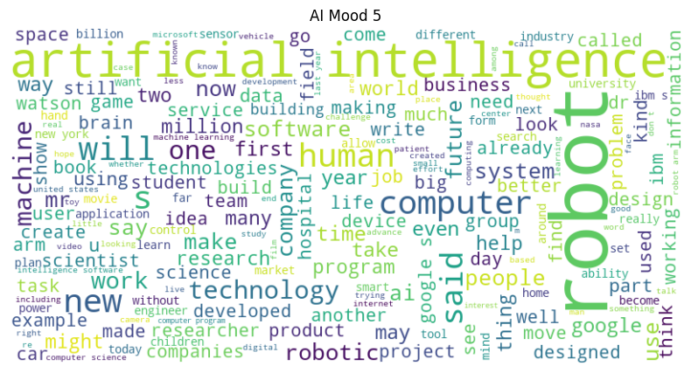
ANALYZING
WORDCLOUDS

Slide 14
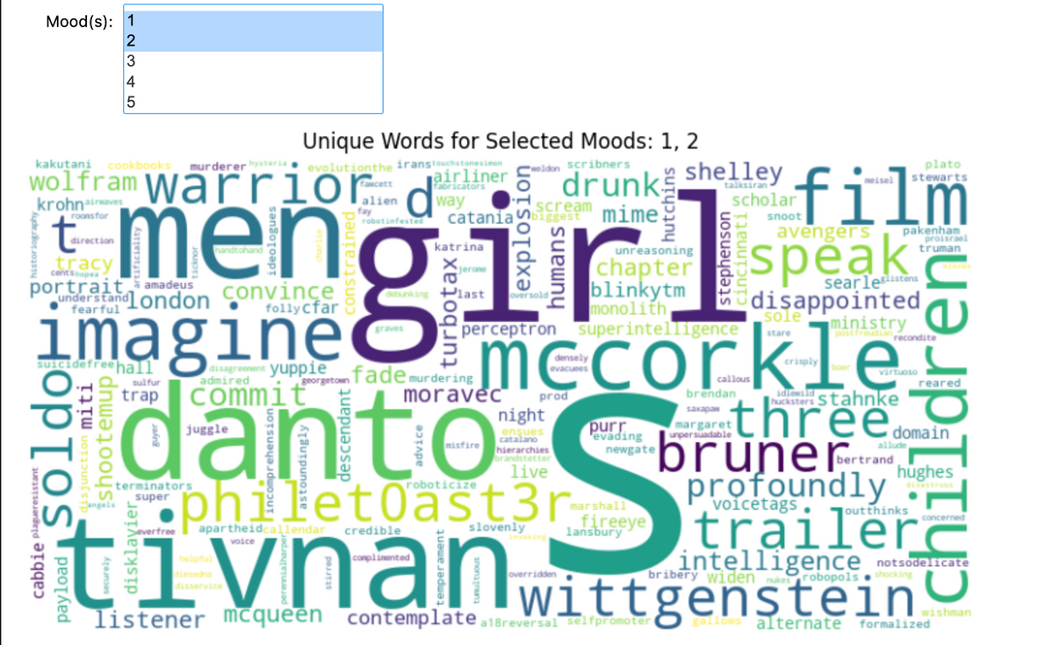
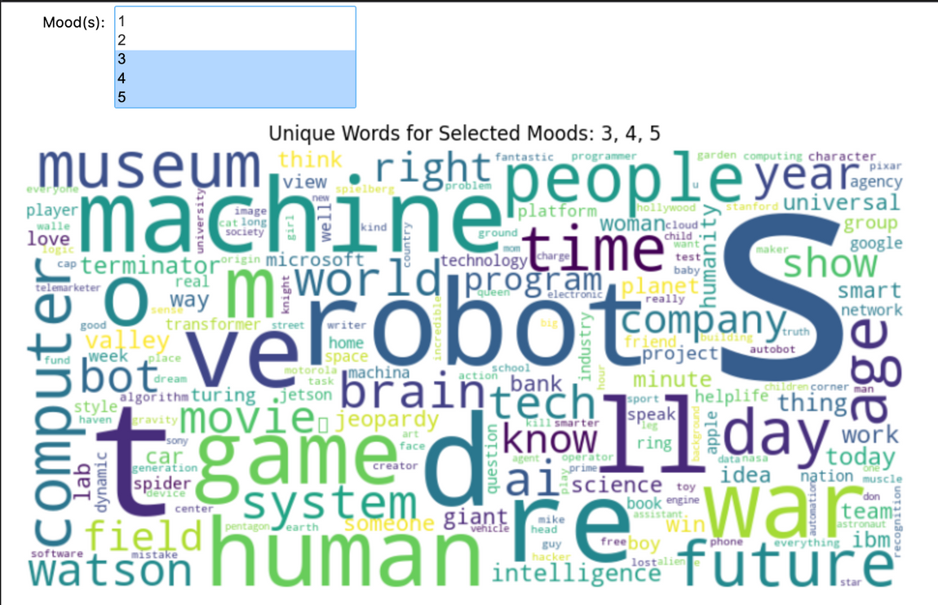
ANALYZING
WORDCLOUDS

Slide 15
ANALYZE
RESULTS
In negative articles, we can observe that it tends to talk more about rumors or warnings about AI from famous people like Stephen Hawking, while in positive articles, it tends to get technical and has more up-to-date talks on AI.
We can filter out some of the words in these clouds which are general and doesn’t add value to analysis, such as “artificial intelligence.”
SOME WORDS UNIQUE TO EACH MOOD THAT YOU MIGHT NOT HAVE SEEN
Mood 1
Mood 5
Stephen Hawking, fear, threat, job, biggest existential, hawking told, military robotics, ban
project, new, designed, google, technologies, used, tool, hospital, idea, IBM, help

Slide 16
RESULTS
IMPACTS
Despite the growing advancements in AI, some of these advancements have led to public concerns about ethical issues such as the misuse of technology and the replacement of jobs.
Since this dataset comes from The New York Times, a popular media platform, it can amplify both the benefits and potential dangers of AI and create mixed feelings among the public.

Slide 17


Questions For Thoughts
It is important to look at who is doing the research in the field of AI perception and look to analyze why this problem exists. It is also important to know who represent the competitors for research in the field. Please see findings below.
Market Research
Significance
Competition
Researchers studying the "Perceptions of AI" are primarily found in the fields of human-computer interaction, social psychology, and artificial intelligence,with prominent figures like Sayash Kapoor from Princeton University
it directly influences how the technology is developed, adopted, and regulated, impacting its societal impact by shaping policy decisions, research priorities, and industry practices, ensuring that AI aligns with public values and concerns, and fostering trust in its applications
Much of the research looking into the public’s perception of AI is centered around academia.

Slide 18
FUTURE?
Analyzing data on historical trends in public perception of AI can help address business concerns of ethical and societal impacts from AI, build sustainability and trust through AI applications, and align public sector opinions and AI marketing operations.

Slide 19
THANK YOU!

